Slide 1

IBM Capstone Project
Bijaya Basnet
09/02/2026

Slide 2



OUTLINE
Executive Summary
Introduction
Methodology
Results
Visualization – Charts
Dashboard
Discussion
Findings & Implications
Conclusion
Appendix

Slide 3

EXECUTIVE SUMMARY
The analysis examined 18,845 Stack Overflow survey responses.
Established technologies dominate current usage:
JavaScript is the most-used language.
PostgreSQL is the leading database.
AWS is the most-used cloud platform.
Future preferences favor TypeScript, Go, Rust, Redis, and modern frameworks.
Approximately 68.6% of respondents are between 25 and 44 years old.
Bachelor’s and master’s degree holders represent approximately 72.3% of respondents.

Slide 4

INTRODUCTION
Purpose
Identify the technologies developers use today and want to use next year.
Audience
Technology learners, employers, and workforce planners.
Value
The results highlight durable core skills and emerging technologies that may influence training and hiring priorities.
Notes:
[Sources]
- User-provided survey_data_updated CSV and dashboard results.

Slide 5

METHODOLOGY
• Source: 2024 Stack Overflow Developer Survey dataset
• Records analyzed: 18,845 respondents
• Multi-select technology fields were separated at semicolons
• Each technology was counted by respondent
• Top 10 values were ranked for current and desired use
• Null values were excluded where necessary
• Dashboards were built in Google Looker Studio
Notes:
[Sources]
- User-provided survey_data_updated CSV.

Slide 6
RESULTS
Current usage, future preferences, and demographics reveal a stable core technology stack with selective interest in newer tools.
Notes:
[Sources]
- User-provided survey_data_updated CSV.

Slide 7
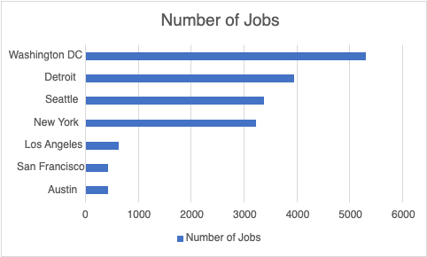
JOB POSTINGS
In Module 1 you have collected the job posting data using Job API in a file named “job-postings.xlsx”. Present that data using a bar chart here. Order the bar chart in the descending order of the number of job postings.

Slide 8
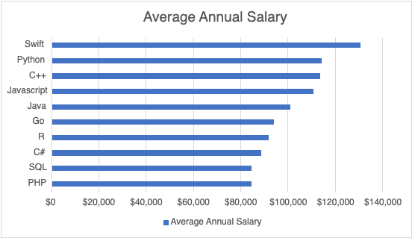
POPULAR LANGUAGES
In Module 1 you have collected the job postings data using web scraping in a file named “popular-languages.csv”. Present that data using a bar chart here. Order the bar chart in the descending order of salary.

Slide 9
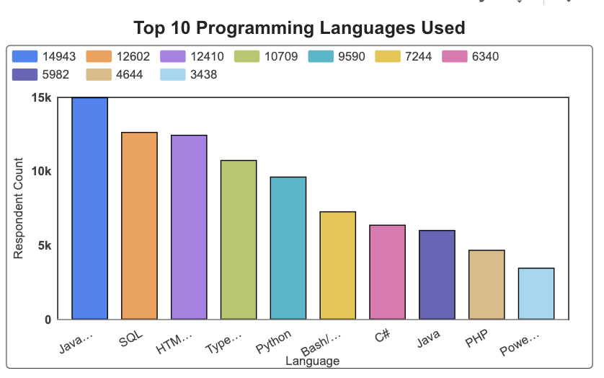
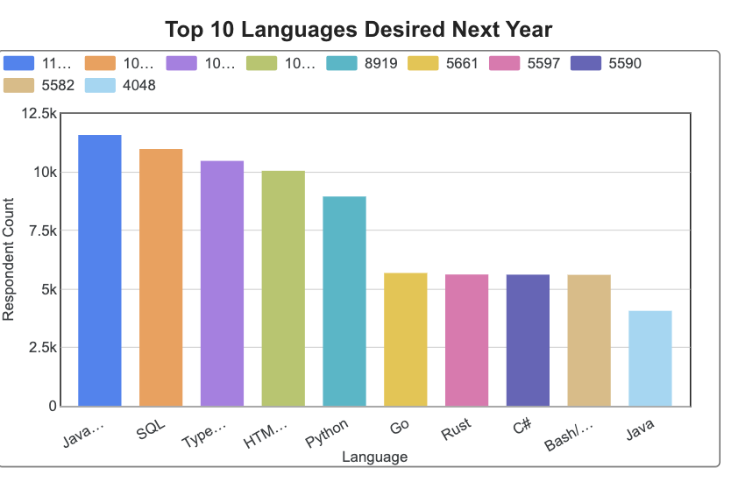
PROGRAMMING LANGUAGE TRENDS
Summarize key trends shown in the charts.
Current Year
Next Year

Slide 10
PROGRAMMING LANGUAGE TRENDS — FINDINGS & IMPLICATIONS
FINDINGS
• JavaScript remains #1
• TypeScript moves to #3 in desired use
• Go and Rust enter the desired top 10
• Python remains a core general-purpose skill
IMPLICATIONS
• Keep JavaScript, SQL, and Python in core curricula
• Pair JavaScript training with TypeScript
• Add elective pathways for Go and Rust
• Emphasize transferable programming concepts
Notes:
[Sources]
- User-provided survey_data_updated CSV.

Slide 11
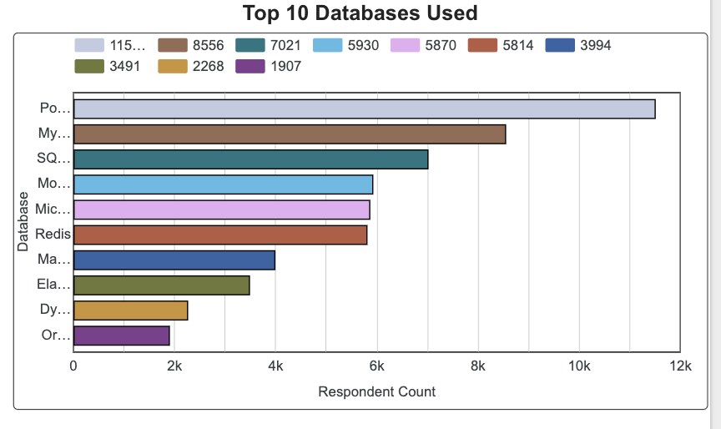
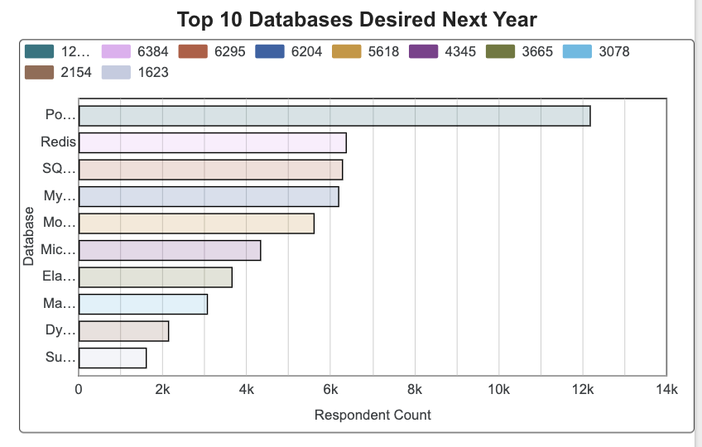
DATABASE TRENDS
Summarize key trends shown in the charts.
Current Year
Next Year

Slide 12
DATABASE TRENDS — FINDINGS & IMPLICATIONS
FINDINGS
• PostgreSQL leads both rankings
• Redis rises sharply in desired use
• SQLite remains highly relevant
• MySQL stays popular but loses relative position
IMPLICATIONS
• Prioritize PostgreSQL proficiency
• Teach caching and in-memory data concepts with Redis
• Retain MySQL and SQLite fundamentals
• Cover both relational and NoSQL design choices
Notes:
[Sources]
- User-provided survey_data_updated CSV.

Slide 13

DASHBOARD

Slide 14
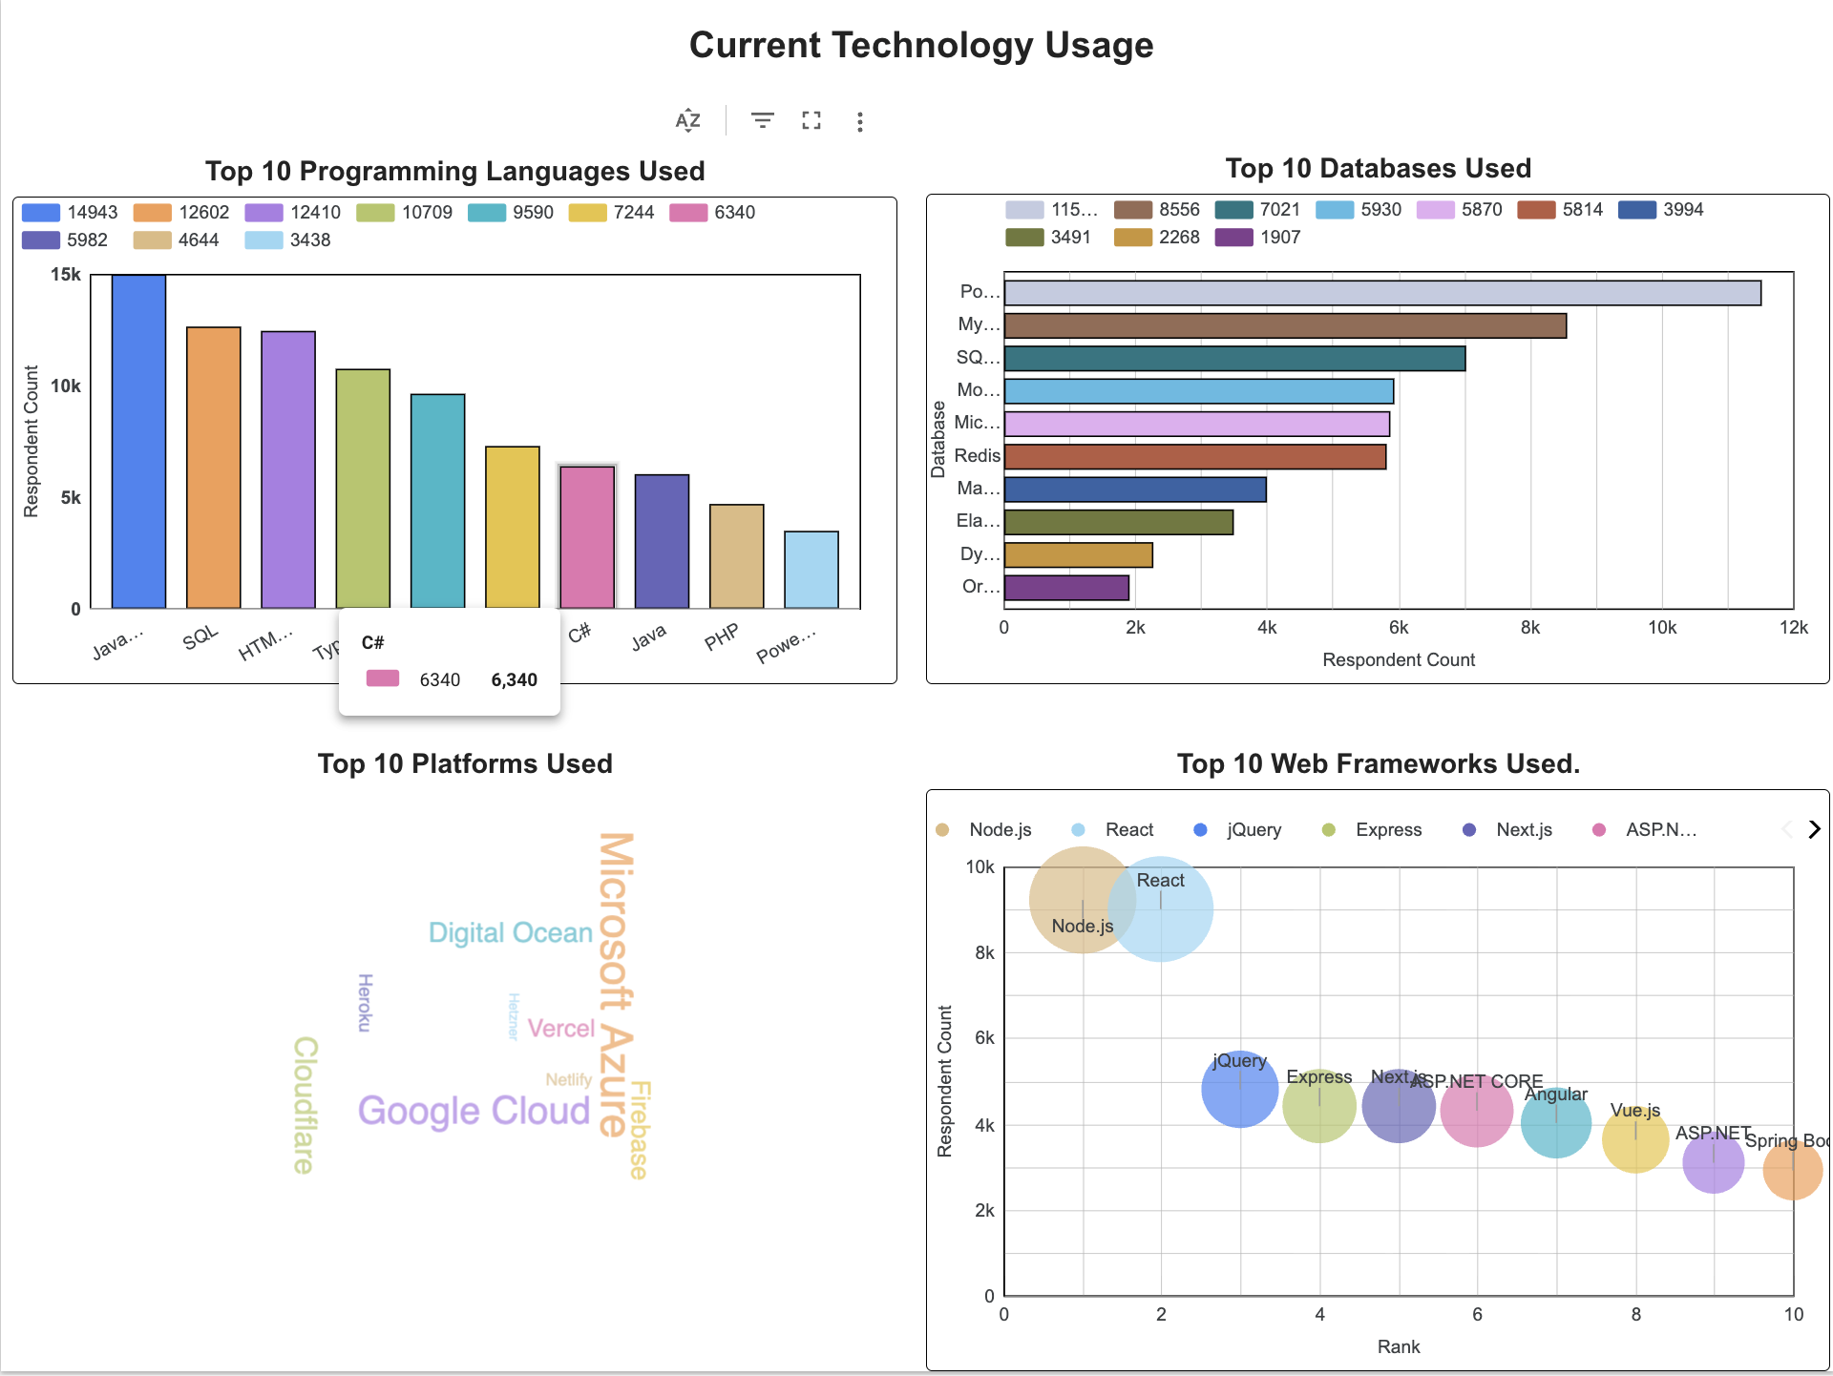
DASHBOARD TAB 1: Current Technology Usage
Dashboard Insight: JavaScript, PostgreSQL, AWS, Node.js, and React are the leading technologies currently used by respondents.
Key Insights: Web development, relational databases, and major cloud platforms dominate the current technology landscape.

Slide 15
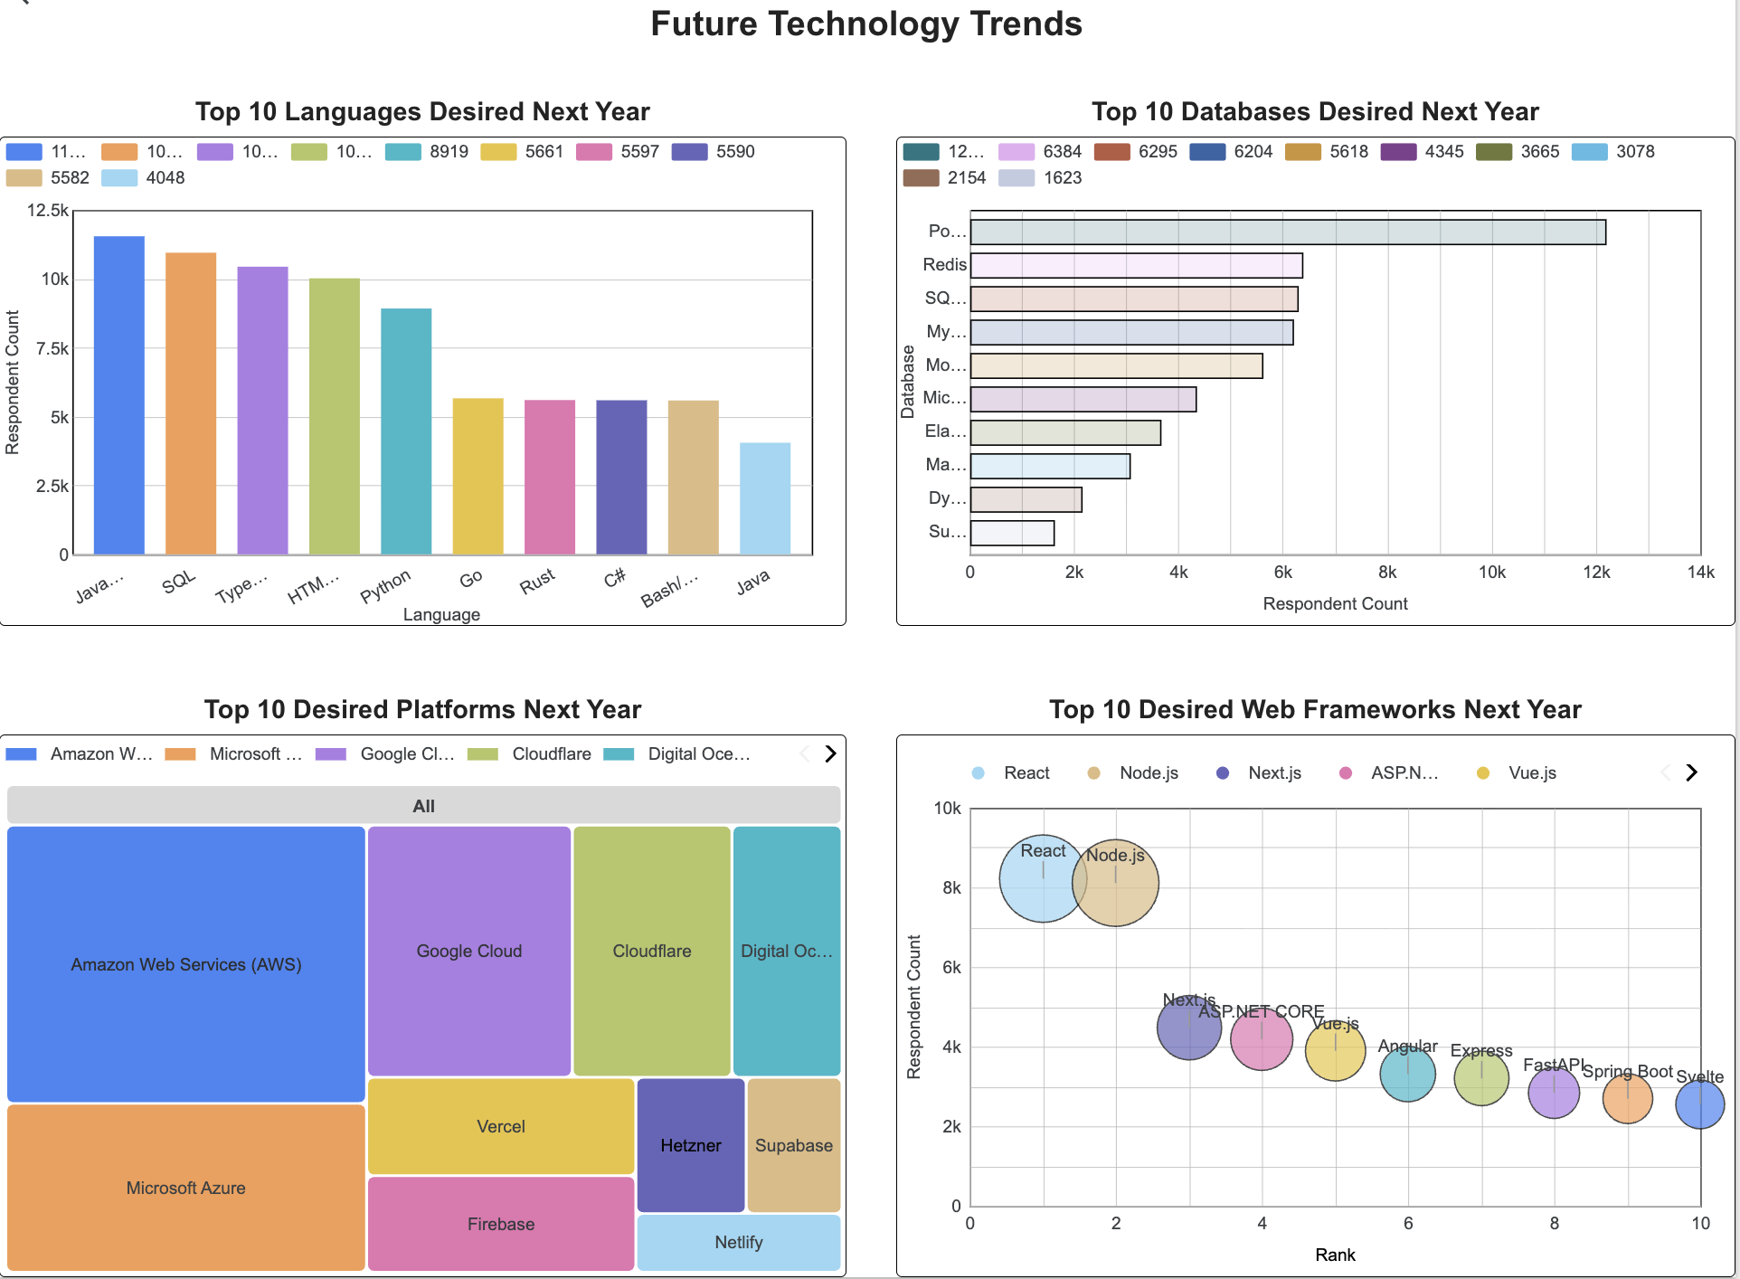
DASHBOARD TAB 2: Future Technology Trends
Dashboard Insight: JavaScript, SQL, TypeScript, PostgreSQL, AWS, React, and Node.js remain the most desired technologies.
Key Insights: Developers favor established technologies while showing increased interest in Go, Rust, Redis, Cloudflare, and modern web frameworks.

Slide 16
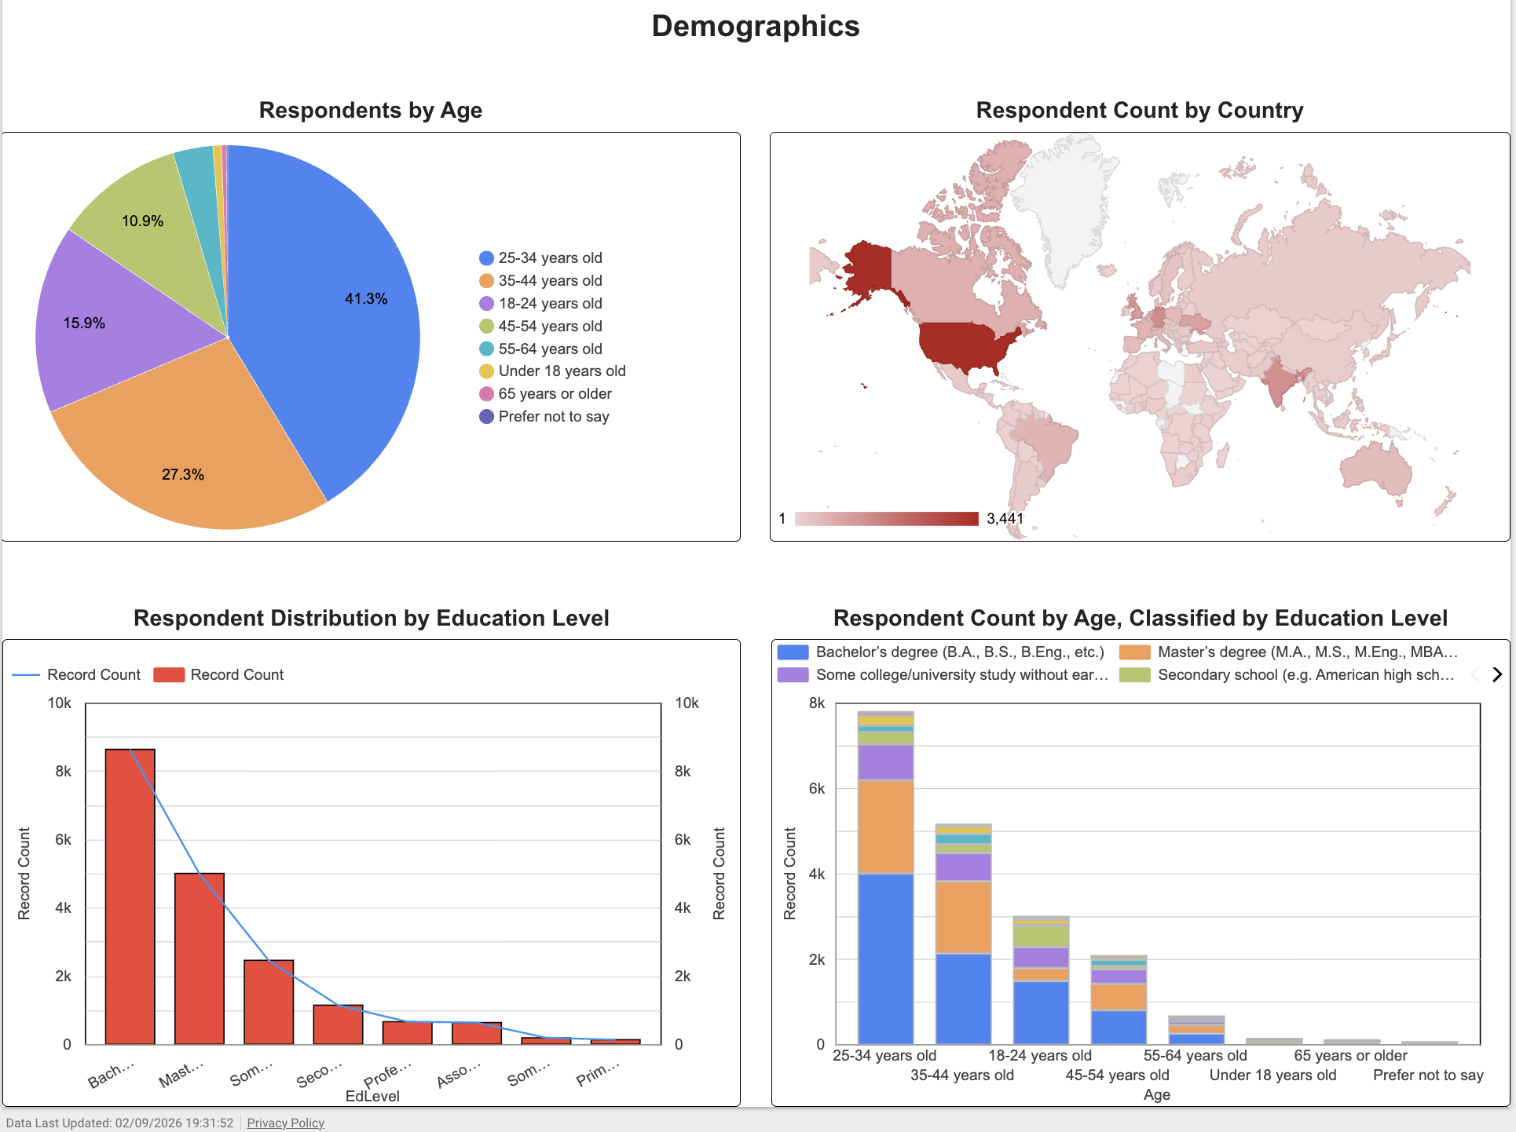
DASHBOARD TAB 3: Demographics
Dashboard Insight: Most respondents are ages 25–44, live primarily in the United States, and hold bachelor’s or master’s degrees.
Key Insights: The survey represents a global but highly educated developer population concentrated in the middle stages of their careers.

Slide 17
DISCUSSION
The results show continuity rather than wholesale replacement. Developers still rely on established languages and platforms, but desired-use rankings reveal targeted shifts toward typed JavaScript, systems languages, faster data layers, and modern deployment tools. Because the survey permits multiple selections, counts reflect overlapping technology ecosystems.
Notes:
[Sources]
- User-provided survey_data_updated CSV and Looker Studio dashboards.

Slide 18
OVERALL FINDINGS & IMPLICATIONS
FINDINGS
• Web technologies dominate
• PostgreSQL is the database leader
• AWS remains the platform leader
• Ages 25–44 form 68.6% of respondents
IMPLICATIONS
• Build skills around durable foundations
• Add TypeScript, Go, Rust, and Redis exposure
• Support cloud-first learning pathways
• Design training for varied education backgrounds
Notes:
[Sources]
- User-provided survey_data_updated CSV and Looker Studio dashboards.

Slide 19

CONCLUSION
• JavaScript, SQL, TypeScript, HTML/CSS, and Python remain essential
• PostgreSQL and AWS anchor the data and cloud ecosystems
• Future interest favors selective modernization—not abandonment of core tools
• The dashboards translate survey responses into practical learning and workforce priorities
Notes:
[Sources]
- User-provided survey_data_updated CSV and Looker Studio dashboards.

Slide 20

APPENDIX
Definitions
• Current usage: technology selected under “Have Worked With”
• Future interest: technology selected under “Want to Work With”
• Respondent count: number of survey records mentioning a technology
• Multi-select responses were split using semicolon delimiters
• Top-10 rankings exclude blank values
Notes:
[Sources]
- User-provided survey_data_updated CSV.

